Slide 1
ADO^{ActiveX Data Objects}.NET

Slide 2
What is ADO.NET ?
It is a part of the base class library that is included with the Microsoft .NET framework.
It is used by programmers to access and modify data stored in relational database systems.
ADO.NET is a technology designed to let an ASP.NET program (or any other .NET program, for that matter) access data .
Notes:
ADO is an abbreviation of "ActiveX Data Objects".
Microsoft's ActiveX Data Objects (ADO) consists of an order of sequence of Component Object Model (COM) objects for accessing sources of data in computing.

Slide 3
Cont.
ADO.NET relies on the functionality in a small set of core classes
Container Class
Used to contain and manage data
DataSet, DataTable, DataRow and DataRelation
Connector Class
Used to connect to a specific data source
Connection, Command and DataReader
Notes:
ADO.NET relies on the functionality in a small set of core classes. You can divide these classes into two groups:
those that are used to contain and manage data (such as DataSet, DataTable, DataRow, and DataRelation) and
those that are used to connect to a specific data source (such as Connection, Command, and DataReader).
The data container classes are completely generic. No matter what data source you use, after you extract the
data, it’s stored using the same data container: the specialized DataSet class. Think of the DataSet as playing the
same role as a collection or an array—it’s a package for data. The difference is that the DataSet is customized for
relational data, which means it understands concepts such as rows, columns, and table relationships natively.
The second group of classes exists in several flavors. Each set of data interaction classes is called an ADO.
NET data provider. Data providers are customized so that each one uses the best-performing way of interacting
with its data source. For example, the SQL Server data provider is designed to work with SQL Server. Internally,
it uses SQL Server’s tabular data stream (TDS) protocol for communicating, thus guaranteeing the best possible
performance. If you’re using Oracle, you can use an Oracle data provider (which is available at
http://tinyurl.com/2wbsjp6) instead.

Slide 4
Important Namespaces
System.Data
System.Data.SqlClient
System.Data.SqlTypes
Notes:
System.Data: Contains fundamental classes with the core ADO.NET functionality. These include DataSet and DataRelation, which allow you to manipulate structured
relational data. These classes are totally independent of any specific type of database or the way you connect to it.
System.Data.SqlClient Contains the classes you use to connect to a Microsoft SQL Server database and execute commands (such as SqlConnection and SqlCommand).
System.Data.SqlTypes Contains structures for SQL Server–specific data types such as SqlMoney and SqlDateTime. You can use these types to work with SQL Server data types without needing to convert them into the standard .NET equivalents (such as System.Decimal and System.DateTime). These types aren’t required, but they do allow
you to avoid any potential rounding or conversion problems that could adversely affect data.

Slide 5
Interaction with Database
Direct Database Access
You don’t keep a copy of the information in memory.
Instead, you work with it for a brief period of time while the database connection is open, and then close the connection as soon as possible.

Slide 6
Cont.
Disconnected Access
You keep a copy of the data in the Dataset object so you can work with it after the database connection has been closed.

Slide 7
Cont.
The direct data model is well suited to ASP.NET web pages
No need to keep a copy of their data in memory for long periods of time
ASP.NET Page Load →Request
ASP.NET Page Shutdown → Response
Performance improvement with Disconnected access
Could get the product catalog from a database once, and keep that data in memory on the web server so you can reuse it when someone else requests the same page
Caching
Notes:
The direct data model is well suited to ASP.NET web pages, which don’t need to keep a copy of their data in memory for long periods of time. Remember, an ASP.NET web page is loaded when the page is requested and shut down as soon as the response is returned to the user. That means a page typically has a lifetime of only a few seconds (if that).
Although ASP.NET web pages don’t need to store data in memory for ordinary data management tasks, they just might use this technique to optimize performance. For example, you could get the product catalog from a database once, and keep that data in memory on the web server so you can reuse it when someone else requests the same page. This technique is called caching,

Slide 8
Direct Data Access
Your Web Page Code
DataReader
Object
Command Object
(Connection)
Connection
Object
Database
Retrieve read-only, fast-forward data
Send direct
Update/ Delete
command
Command Object
(Connection)

Slide 9
Steps Involved
To query information
Create Connection, Command, and DataReader objects.
Use the DataReader to retrieve information from the database, and display it in a control on a web form.
Close your connection
Send the page to the user.
At this point, the information your user sees and the information in the database no longer have any connection, and all the ADO.NET objects have been destroyed.

Slide 10
Steps Involved
To add/ update information
Create new Connection and Command objects.
Execute the command

Slide 11
Connection Object
The first thing that we will have to do, when working with databases is to create a connection object.
2 Ways of creating connection object
Do not hard code connection string: Web.config
Notes:
Demo
D:\Personal\WDDN\C# Codes 2019-20\ADONET_Demo1

Slide 12
Ways to Specify Connection String
SqlConnection con = new SqlConnection(@"Data Source=(LocalDB)\MSSQLLocalDB;AttachDbFilename=D:\Personal\WDDN\C# Codes 2019-20\ADONET_Demo1\ADONET_Demo1\App_Data\Test.mdf;Integrated Security=True");
SqlConnection con = new SqlConnection();
con.ConnectionString = @"Data Source=(LocalDB)\MSSQLLocalDB;AttachDbFilename=D:\Personal\WDDN\C# Codes 2019-20\ADONET_Demo1\ADONET_Demo1\App_Data\Test.mdf;Integrated Security=True";
Notes:
Not a good approach.

Slide 13
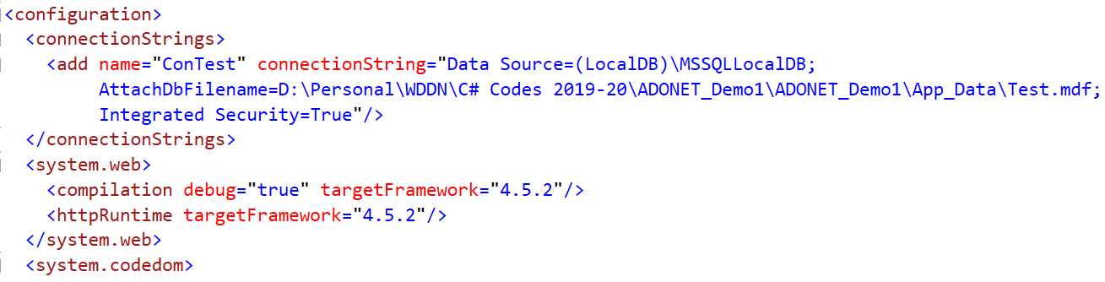
<connectionStrings>
<add name="ConTest" connectionString="Data Source=(LocalDB)\MSSQLLocalDB;AttachDbFilename=D:\Personal\WDDN\C# Codes 2019-20\ADONET_Demo1\ADONET_Demo1\App_Data\Test.mdf;Integrated Security=True"/>
</connectionStrings>
Notes:
Web.config

Slide 14
Access Connection String from Web.config
using System.Web.Configuration;
SqlConnection con = new SqlConnection();
con.ConnectionString = WebConfigurationManager.ConnectionStrings["ConTest"].ConnectionString;

Slide 15
ConnectionString and Properties
Key/Value pairs that has the information required to create a connection object
Properties
Data Source
Initial Catalog
SSIP
Connection Timeout
Notes:
ConnectionString defines all the information the computer needs to find the data source, log in, and choose an initial database. The connection string is actually a series of distinct pieces of information separated by semicolons
Data Source : This indicates the name of the server where the data source is located.
Initial Catalog : This is the name of the database that this connection will use.
SSPI (which stands for Security Support Provider Interface) : This indicates that you want to connect to SQL Server by using the Windows user account or SQL Authentication. Connection Timeout : This determines the number of seconds your code will wait before generating an error if it cannot establish a database connection. the default of 15 seconds is used. 0 to specify no limit

Slide 16
Open and Close Connection
Create Connection
SqlConnection con = new SqlConnection();
Open Connection
con.Open()
Do your tasks
//
Close your Connection
con.Close()
Notes:
myConnection.Open();
After you use the Open() method, you have a live connection to your database.
One of the most fundamental principles of data access code is that you should reduce the amount of time you hold a connection open as much as possible.
myConnection.Close();

Slide 17
Alternatives
using(object)
{
…
}
Disposable Object
CLR
Dispose()
Dispose()←→Close()
Shorten database code
No need of finally block
Notes:
The using statement declares that you are using a disposable object for a short period of time.
As soon as you finish using that object and the using block ends, the CLR will release it immediately by calling the Dispose() Method.
It just so happens that calling the Dispose() method of a connection object is equivalent to calling Close() and then discarding the connection object from memory.
That means you can shorten your database code with the help of a using block.
The best part is that you don’t need to write a finally block—the using statement releases the object you’re using even if you exit the block as the result of an unhandled exception.

Slide 18
Command Object
A Command object executes the SQL statement
string command = "Select * from Food";
SqlCommand cmd = new SqlCommand(command, con);
OR
SqlCommand cmd = new SqlCommand()
cmd.Conenction = con;
cmd.CommandText = “Select * from Food”
Notes:
Command objects represent SQL statements. To use a Command object, you define it, specify the SQL
statement you want to use, specify an available connection, and execute the command.
Prepare SQL Statement.
Prepare command object and supply SQL statement and Connection string.
Example :
SqlCommand myCommand = new SqlCommand(); myCommand.Connection = myConnection; myCommand.CommandText = "SELECT * FROM Authors ORDER BY au_lname ";
To ensure good database
performance, you should open your connection just before you execute your command and close it as soon as
the command is finished.

Slide 19
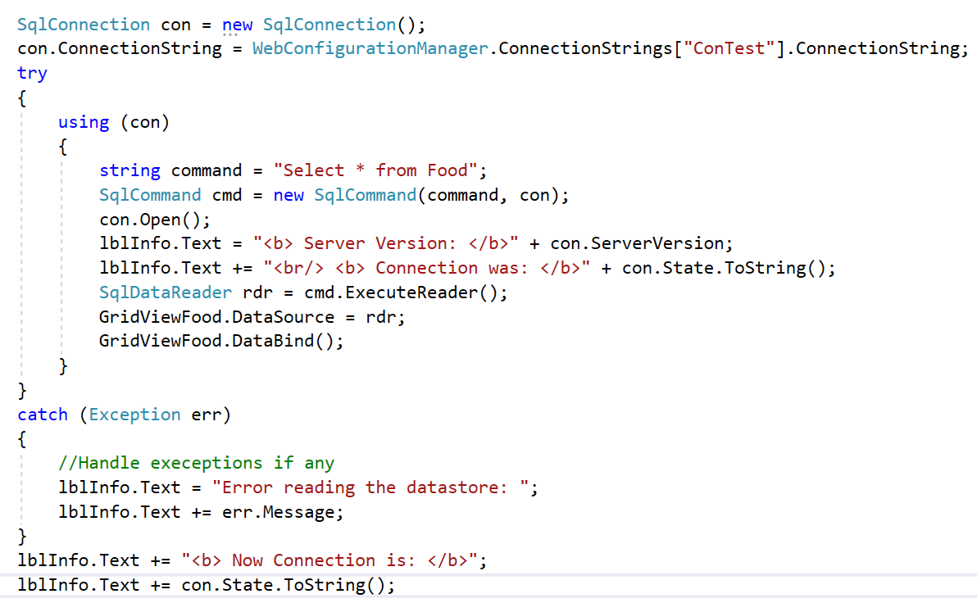
Notes:
WebForm1.aspx.cs: Code in Page_Load
Demo
D:\Personal\WDDN\C# Codes 2019-20\ADONET_Demo1

Slide 20
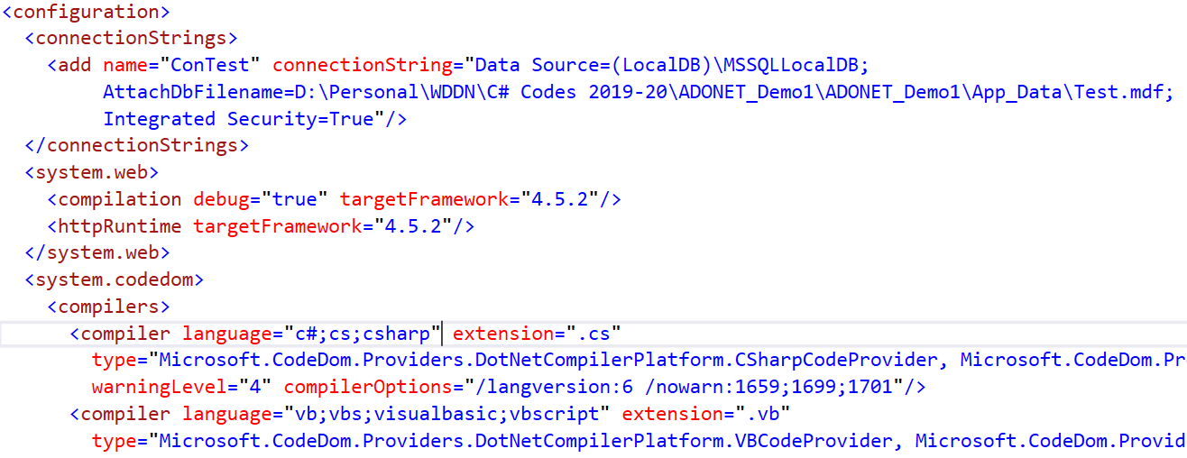
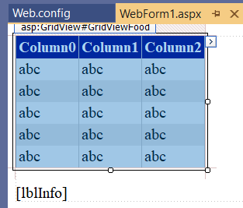
Notes:
Connection string in web.config
Gridview control and label control in aspx page

Slide 21
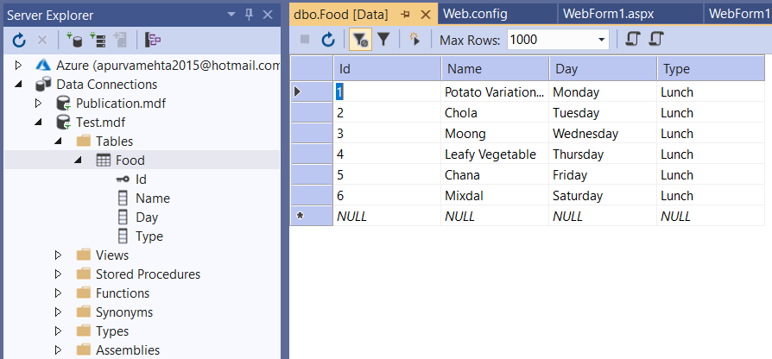
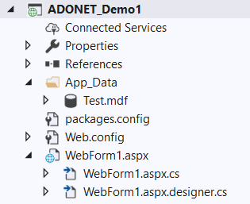
Notes:
Database in Server Explorer
Database in Solution Explorer, App_Data of project

Slide 22
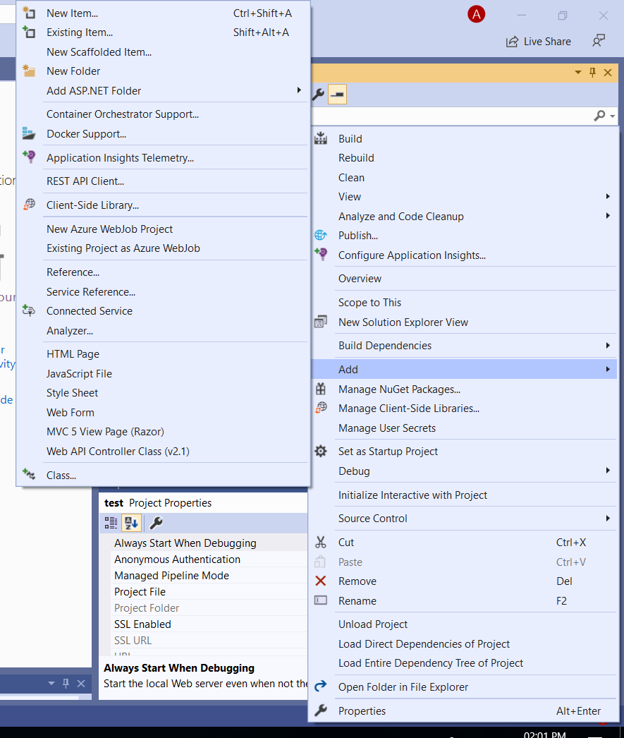
Notes:
Right click on your project, Add, Add New Item
How to add sql server database into App_Data of your project

Slide 23
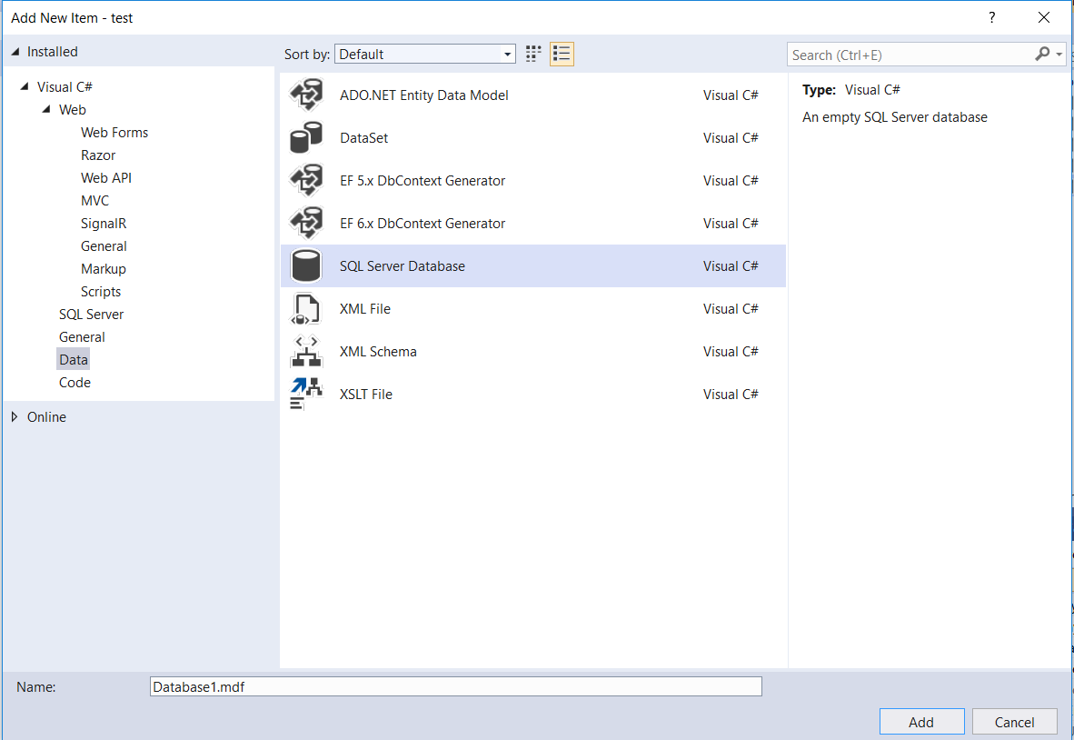
Notes:
SQL Server Database from Data tab, Click Add

Slide 24
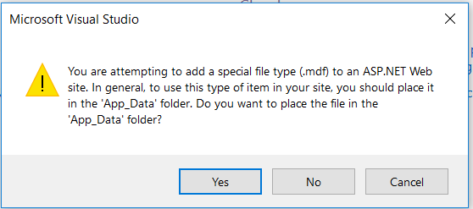
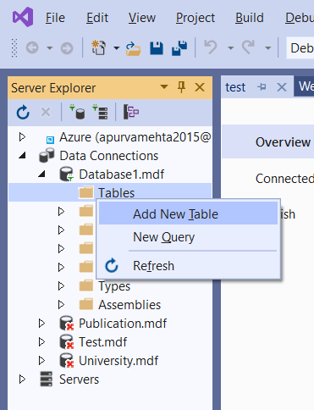
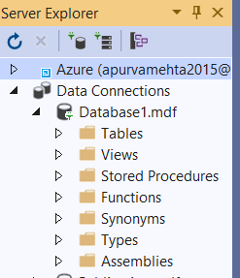
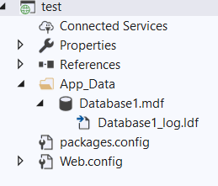

Slide 25
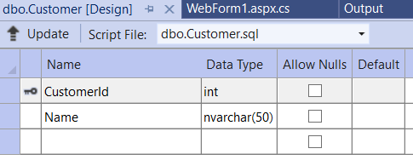
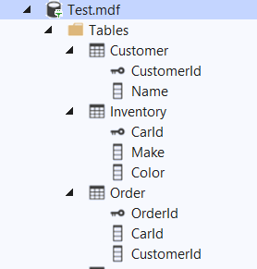
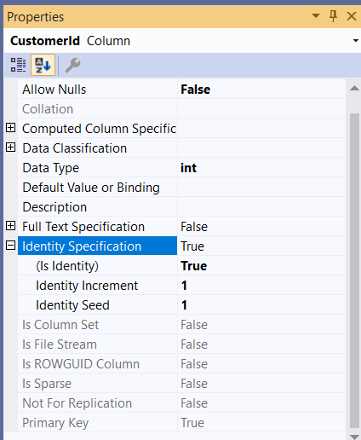
Notes:
How to set auto increment pk

Slide 26
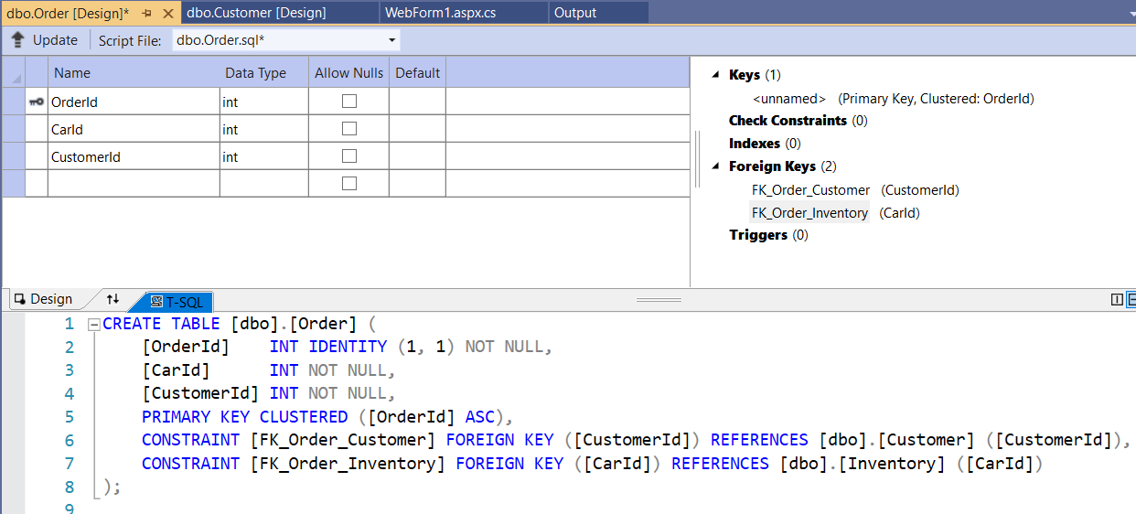
Notes:
How to set fk
Add column, Right click on Foreign keys and Add new foreign key, entry is created into TSQL, modify accordingly

Slide 27
Notes:
Come back to our demo:WebForm1.aspx.cs: Code in Page_Load
Demo
D:\Personal\WDDN\C# Codes 2019-20\ADONET_Demo1

Slide 28
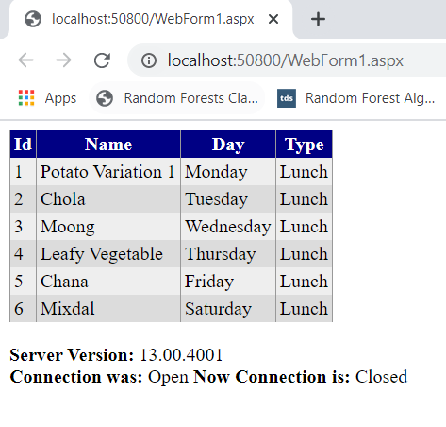
Connection is closed first and then exception-handling code is triggered
It’s always good to close database connections as soon as possible
Notes:
Come back to our demo
Select * from Food
There’s one difference in the way this code is implemented as compared to the previous example. The errorhandling
code wraps the using block. As a result, if an error occurs, the database connection is closed first, and
then the exception-handling code is triggered. In the first example, the error-handling code responded first, and
then the finally block closed the connection afterward. Obviously, this rewrite is a bit better, as it’s always good
to close database connections as soon as possible.

Slide 29
DataReader
After command is defined
Quickly retrieve all your results
Fast-forward-only read-only access
con.Open();
SqlDataReader rdr = cmd.ExecuteReader();
rdr.Read();
Notes:
After you’ve defined your command, you need to decide how you want to use it. The simplest approach is to use
a DataReader, which allows you to quickly retrieve all your results. The DataReader uses a live connection and
should be used quickly and then closed. The DataReader is also extremely simple. It supports fast-forward-only
read-only access to your results (row by row reading data), which is generally all you need when retrieving information. Because of the
DataReader’s optimized nature, it provides better performance than the DataSet. It should always be your first
choice for direct data access..
Before you can use a DataReader, make sure you’ve opened the connection:
con.Open();
To create a DataReader, you use the ExecuteReader() method of the command object, as shown here:
// You don't need the new keyword, as the Command will create the DataReader.
SqlDataReader rdr;
rdr = cmd.ExecuteReader();
These two lines of code define a variable for a DataReader and then create it by executing the command.
After you have the reader, you retrieve a single row at a time by using the Read() method:
rdr.Read();

Slide 30
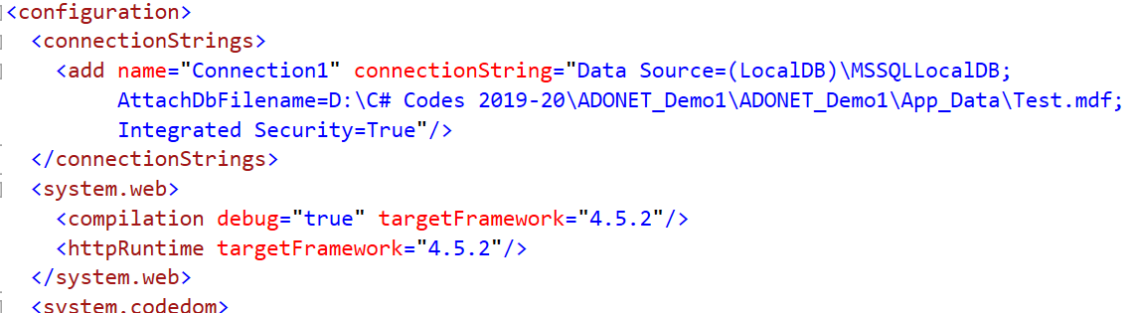
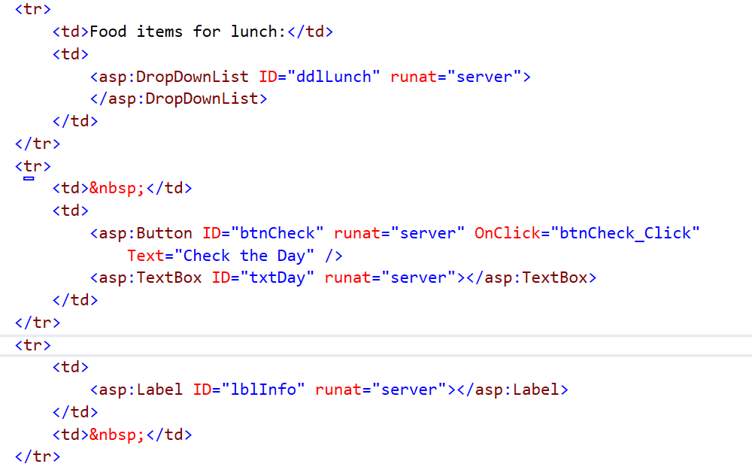
Notes:
Connection string in Web.config
aspx code

Slide 31
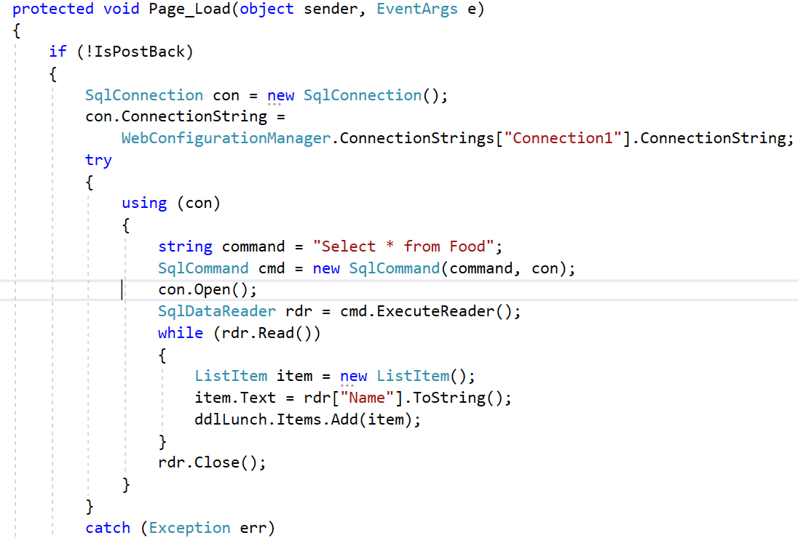
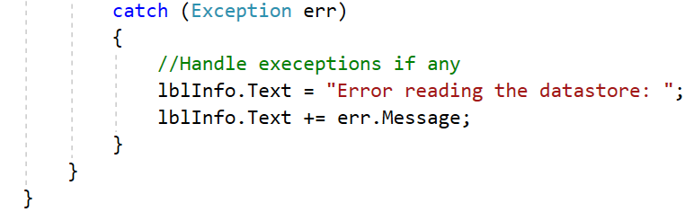
Notes:
Demo
D:\Personal\WDDN\C# Codes 2019-20\ADONET_Demo1\ADONET_Demo2
ExecuteReader gives you a data reader back which will allow you to read all of the columns of the results a row at a time.
Return type is DataReader.
Return value is compulsory and should be assigned to an another object DataReader.

Slide 32
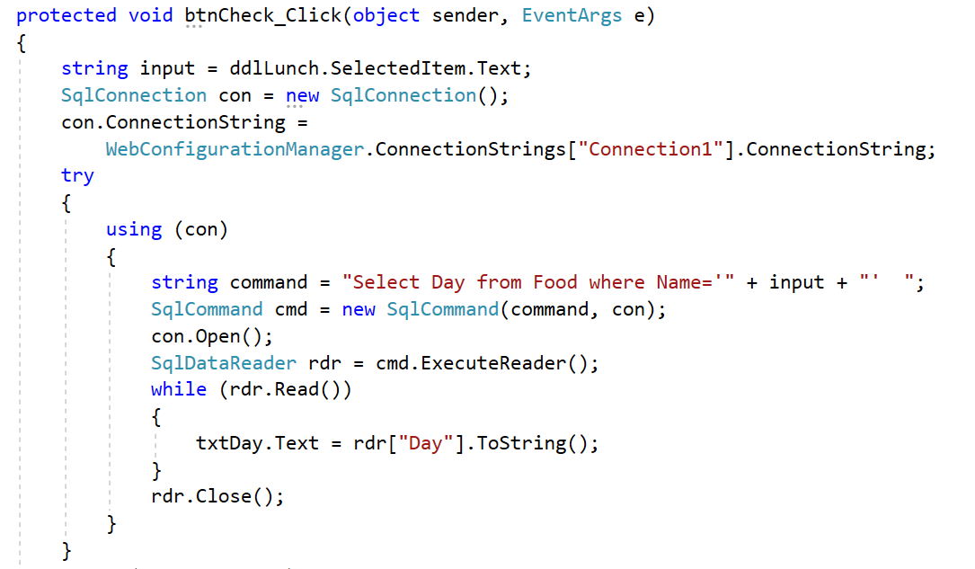
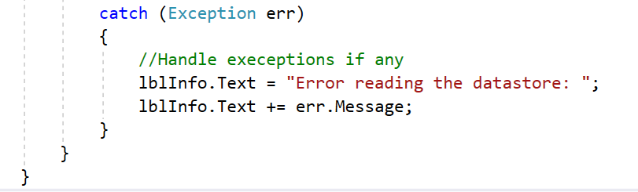

Slide 33
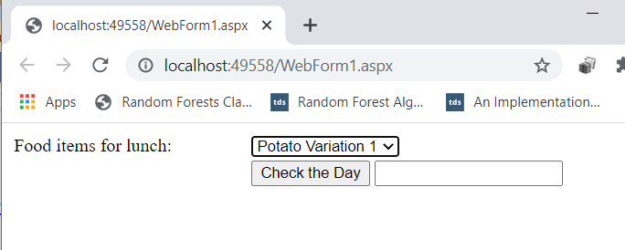
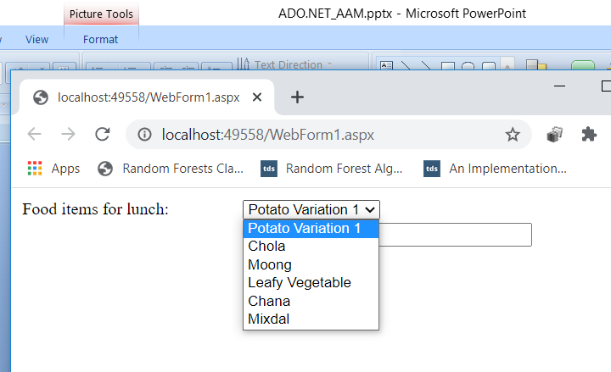
Notes:
Page load
Items in ddl

Slide 34
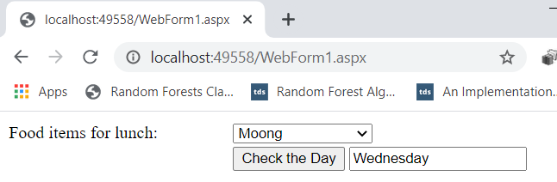
Notes:
Button event

Slide 35
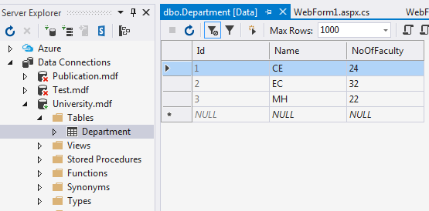
Application
Notes:
Try it
D:\Personal\WDDN\C# Codes 2019-20\ADONET_Demo1\ADONET_StudentTeacher

Slide 36
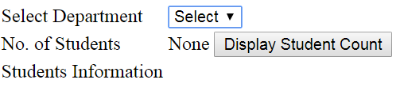
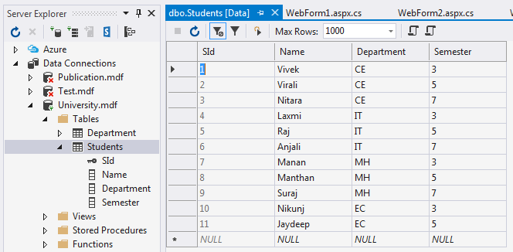
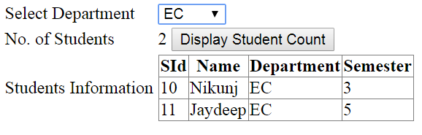
Application
Notes:
D:\Personal\WDDN\C# Codes 2019-20\ADO_Direct_Data_Access\Relationships_Demo

Slide 37
using (con)
{
string command = "Select * from Department";
SqlCommand cmd = new SqlCommand(command, con);
con.Open();
SqlDataReader rdr = cmd.ExecuteReader();
while (rdr.Read())
{
ListItem item = new ListItem();
item.Text = rdr["Name"].ToString();
ddlDept.Items.Add(item);
}
rdr.Close();
}

Slide 38
ExecuteReader()
ExecuteReader gives you a data reader back which will allow you to read all of the columns of the results a row at a time.
Return type is DataReader.
Return value is compulsory and should be assigned to an another object DataReader.

Slide 39
ExecuteNonQuery()
ExecuteNonQuery is used to execute SQL Statement and it returns number of rows affected.
We cannot use ExecuteNonQuery while we are expecting some data from the SQL query.
We can use ExecuteNonQuery in INSERT, UPDATE and DELETE queries where they are not returning any result.
Return type is int.
Return value is optional and can be assigned to an integer variable.

Slide 40
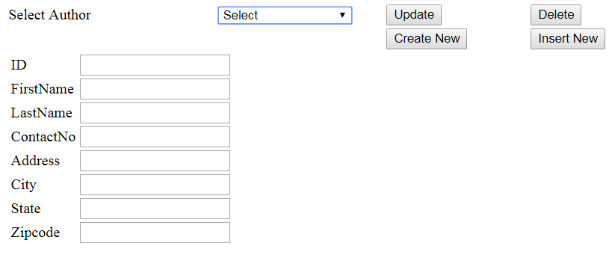
Exercise
Notes:
D:\Personal\WDDN\C# Codes 2019-20\ADONET_Demo1\ADONET_AuthorApp

Slide 41
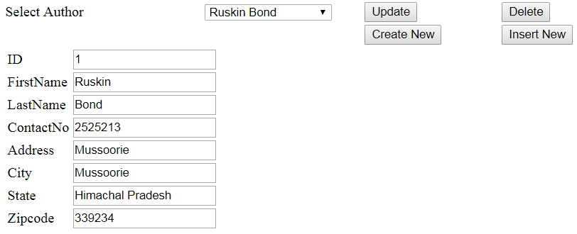
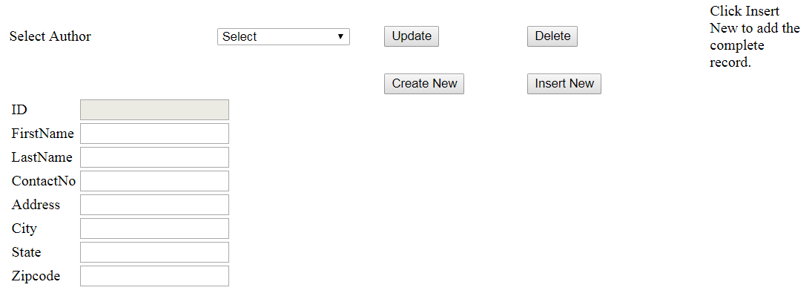

Slide 42
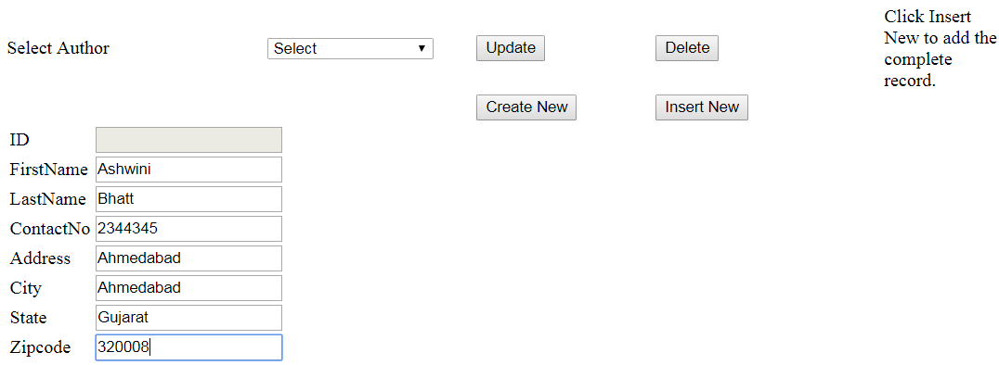
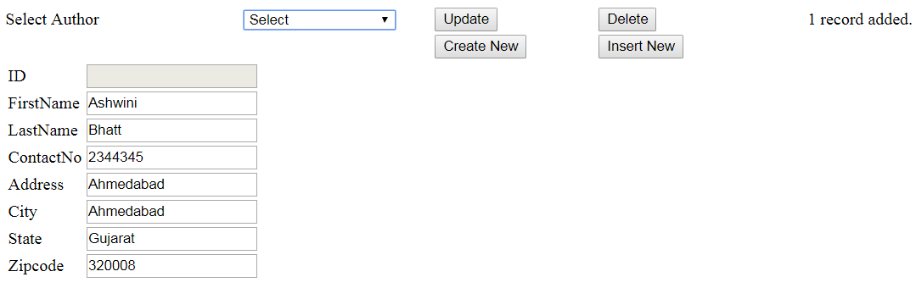

Slide 43
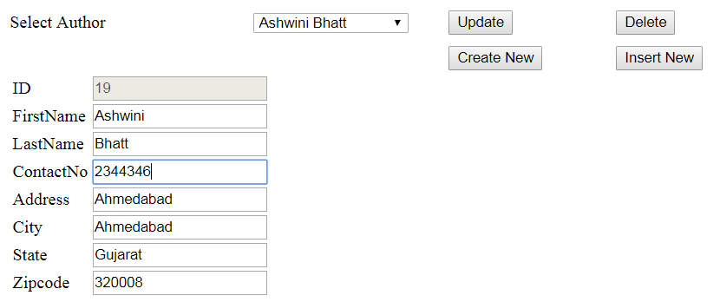
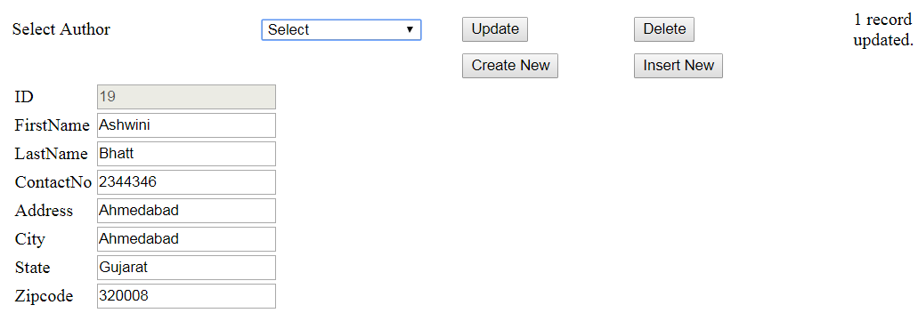

Slide 44
Sample Sql Statements
string query = "INSERT INTO Products (Name, Price, Date) VALUES(@Name, @Price, @Date)";
cmd.Parameters.AddWithValue("@Name", "USB Keyboard");
cmd.Parameters.AddWithValue("@Price", "20");
cmd.Parameters.AddWithValue("@Date", "25 May 2017");
Notes:
Why Parameterized Command
Users may accidentally enter characters that will affect your SQL statement.
Users might deliberately enter characters that will affct your SQL statement. ( SQL Injection)
A parameterized command is one that replaces hard-coded values with placeholders.
The placeholders are then added separately.
The SQL Statement
SELECT * FROM Customers WHERE CustomerID = ‘ALFKI’ would become
SELECT * FROM Customers WHERE CustomerID = @CustomerID

Slide 45
Cont.
UPDATE Customers SET Name = @Name, Country = @Country WHERE CustomerId = @CustomerId
DELETE FROM Customers WHERE CustomerId = @CustomerId
Notes:
Why Parameterized Command
Users may accidentally enter characters that will affect your SQL statement.
Users might deliberately enter characters that will affct your SQL statement. ( SQL Injection)
A parameterized command is one that replaces hard-coded values with placeholders.
The placeholders are then added separately.
The SQL Statement
SELECT * FROM Customers WHERE CustomerID = ‘ALFKI’ would become
SELECT * FROM Customers WHERE CustomerID = @CustomerID

Slide 46
Disconnected Data Access
Use the DataSet to keep a copy of your data in memory
You need to do something time-consuming with the data
By dumping it into a DataSet first, you ensure that the database connection is kept open for as little time as possible.
You want to navigate backward and forward through your data while you’re processing it.
This isn’t possible with the DataReader, which goes in one direction only—forward.
Notes:
When you use disconnected data access, you use the DataSet to keep a copy of your data in memory. You connect to the database just long enough to fetch your data and dump it into the DataSet, and then you disconnect immediately.
There are a variety of good reasons to use the DataSet to hold onto data in memory. Here are a few:
You need to do something time-consuming with the data. By dumping it into a DataSet first, you ensure that the database connection is kept open for as little time as possible.
You want to use ASP.NET data binding to fill a web control (such as a GridView) with your data. Although you can use the DataReader, it won’t work in all scenarios. The DataSet
approach is more straightforward.
You want to navigate backward and forward through your data while you’re processing it. This isn’t possible with the DataReader, which goes in one direction only—forward.
You want to navigate from one table to another. Using the DataSet, you can store several tables of information. You can even define relationships that allow you to browse through them more efficiently.
You want to save the data to a file for later use. The DataSet includes two methods— WriteXml() and ReadXml()—that allow you to dump the content to a file and convert it
back to a live database object later.
You need a convenient package to send data from one component to another. For example, in Chapter 22 you’ll learn to build a database component that provides its data
to a web page by using the DataSet. A DataReader wouldn’t work in this scenario, because the database component would need to leave the database connection open, which is a dangerous design.
You want to store some data so it can be used for future requests. Chapter 23 demonstrates how you can use caching with the DataSet to achieve this result.

Slide 47
Cont.
You want to navigate from one table to another.
Using the DataSet, you can store several tables of information.
You can even define relationships that allow you to browse through them more efficiently.
You want to save the data to a file for later use.
The DataSet includes two methods—
WriteXml() and ReadXml()—that allow you to dump the content to a file and convert it back to a live database object later

Slide 48
Updating Disconnected Data
The DataSet tracks the changes you make to the records inside.
This allows you to use the DataSet to update records.
The basic principle is simple.
You fill a DataSet in the normal way, modify one or more records, and then apply your update by using a DataAdapter.
Notes:
However, ADO.NET’s disconnected update feature makes far more sense in a desktop application than in a
web application. Desktop applications run for a long time, so they can efficiently store a batch of changes
and perform them all at once. But in a web application, you need to commit your changes the moment they
happen. Furthermore, the point at which you retrieve the data (when a page is first requested) and the point
at which it’s changed (during a postback) are different, which makes it very difficult to use the same DataSet
object, and maintain the change-tracking information for the whole process.
For these reasons, ASP.NET web applications often use the DataSet to store data but rarely use it to
make updates. Instead, they use direct commands to commit changes.

Slide 49
Dataset family of Obejcts
DataTable Object
DataRow Object
DataSet Object
Rows Collection
DataColumn Object
Tables Collection
Columns Collection
Constraints Collection
Constraint Object
Relations Collection
DefaultView
DataView Object
DataRelation Object
Notes:
DefaultView Property is the DataView associated with a DataTable, it can be used to sort, filter, and search a DataTable.

Slide 50
Architecture
Data Provider
Command Builder
Data Set
DataTable
Data Adapter
Rows
Select Command
Columns
Insert Command
Constraints
Update Command
Relations
Delete Command
Connection
DataView
Database
Notes:
Connection : All communication with the external data source occurs through a Connection object.
Command : SQL queries and data management statements get wrapped in a Command object before being sent to the data source.
By default DataAdapter contains only the select command and it doesn’tcontain insert, update and delete commands.
To create insert, update and delete commands for the dataadapter, command builder is used.It is used only to create these commands for the dataadapter and has no other purpose. Commands can include optional Parameter instances that allows to call stored procedures or create queries.
DataAdapter : DataAdapter is used to transfer the data between database and dataset.
The DataAdapter object uses standard query definitions for interacting with a database.
It has commands like select, insert, update and delete.
Select command is used to retrieve data from database and insert, update and delete commands are used to send changes to the data in dataset to database. It needs a connection to transfer the data.
Dataset : Dataset is used to store the data retrieved from database by DataAdapter and make it available for .net application.
To fill data in to DataSet fill() method of DataAdapter is used.
When fill method was called, DataAdapter will open a connection to database, executes select command, stores the data retrieved by select command into DataSet and immediately closes the connection.
As connection to database was closed, any changes to the data in DataSet will not be directly sent to the database and will be made only in the DataSet.
To send changes made to data in dataset to the database, Update() method of the dataadapter is used.
When Update method was called, DataAdapter will again open the connection to database, executes insert, update and delete commands to send changes in DataSet to database and immediately closes the connection.
A DataSet can contain data in multiple tables.
DataTable : DataTable manages all the actual data values. Each DataTable contains zero or more rows of data, with the individual data values of each row identified by the table’s column definitions.
DataColumn : Each table defines DataColumn items, each representing the individual data values that appear in the table’s records. DataColumn definitions include a data type declaration based on the kind of data destined for each column.
DataRelation : We can optionally establish links between the tables of data using DataRelation entries.
Constraint : Programmatic limitations can be placed on tables and their data values using Constraint instances.
DataView : DataView is a view of table available in DataSet. It is used to find a record, sort the records and filter the records. By using DataView, we can also perform insert, update and delete as in case of a DataSet.

Slide 51
Cont.
Connection : All communication with the external data source occurs through a Connection object.
Command : SQL queries and data management statements get wrapped in a Command object before being sent to the data source.
By default DataAdapter contains only the select command and it doesn’tcontain insert, update and delete commands.
To create insert, update and delete commands for the dataadapter, command builder is used.It is used only to create these commands for the dataadapter and has no other purpose.
Commands can include optional Parameter instances that allows to call stored procedures or create queries.

Slide 52
Cont.
DataAdapter : DataAdapter is used to transfer the data between database and dataset.
The DataAdapter object uses standard query definitions for interacting with a database.
It has commands like select, insert, update and delete.
Select command is used to retrieve data from database and insert, update and delete commands are used to send changes to the data in dataset to database. It needs a connection to transfer the data.

Slide 53
Cont.
Dataset : Dataset is used to store the data retrieved from database by DataAdapter and make it available for .net application.
To fill data in to DataSet fill() method of DataAdapter is used.
When fill method was called, DataAdapter will open a connection to database, executes select command, stores the data retrieved by select command into DataSet and immediately closes the connection.
As connection to database was closed, any changes to the data in DataSet will not be directly sent to the database and will be made only in the DataSet.
To send changes made to data in dataset to the database, Update() method of the dataadapter is used.
When Update method was called, DataAdapter will again open the connection to database, executes insert, update and delete commands to send changes in DataSet to database and immediately closes the connection.

Slide 54
Cont.
A DataSet can contain data in multiple tables.
DataTable : DataTable manages all the actual data values. Each DataTable contains zero or more rows of data, with the individual data values of each row identified by the table’s column definitions.
DataColumn : Each table defines DataColumn items, each representing the individual data values that appear in the table’s records. DataColumn definitions include a data type declaration based on the kind of data destined for each column.

Slide 55
Cont.
DataRelation : We can optionally establish links between the tables of data using DataRelation entries.
Constraint : Programmatic limitations can be placed on tables and their data values using Constraint instances.
DataView : DataView is a view of table available in DataSet. It is used to find a record, sort the records and filter the records. By using DataView, we can also perform insert, update and delete as in case of a DataSet.
Notes:
This architecture is called Disconnected Architecture.
ADO.NET was built with the disconnected mode in mind—meaning the entire database table(s) can be retrieved to a temporary file or to a local machine if the database is stored on the network.
After the database data is retrieved, we no longer need to stay connected to it. Processing can occur at the local level. If changes are made to the database, the connection can be remade and the changes posted.
With multitier applications, the database can be stored on a different computer or across the Internet.With the growth of Web-centric applications, this disconnect feature is extremely important.

Slide 56
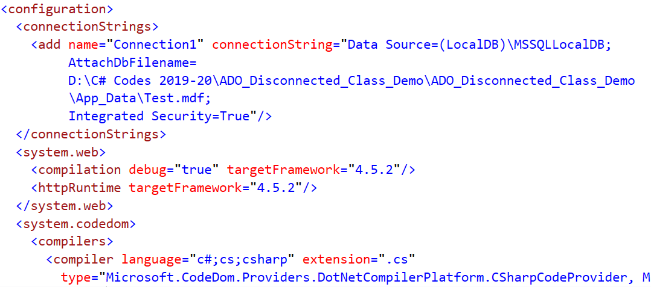
Notes:
Demo:D:\C# Codes 2019-20\ADO_Disconnected_Class_Demo
Web.config

Slide 57
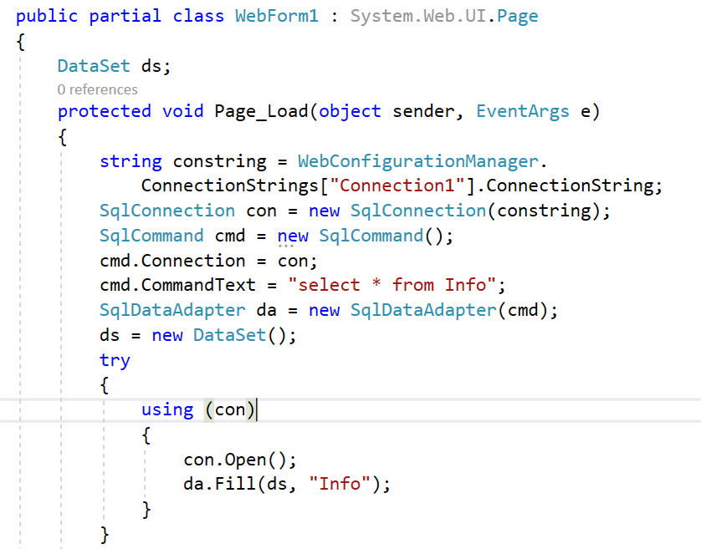
Notes:
Webform1.Aspx.cs

Slide 58
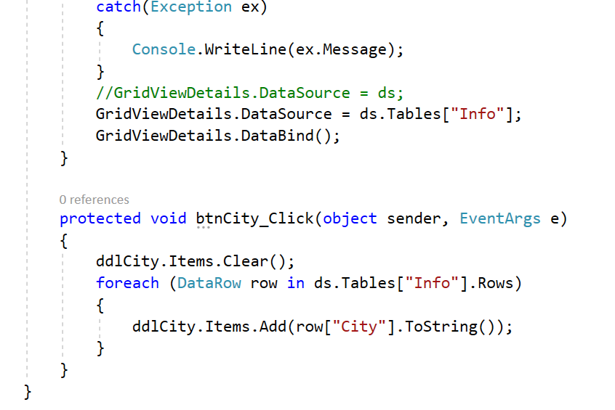
Notes:
//Discuss reason for commented line.
//Change will happen in btn event as well.

Slide 59
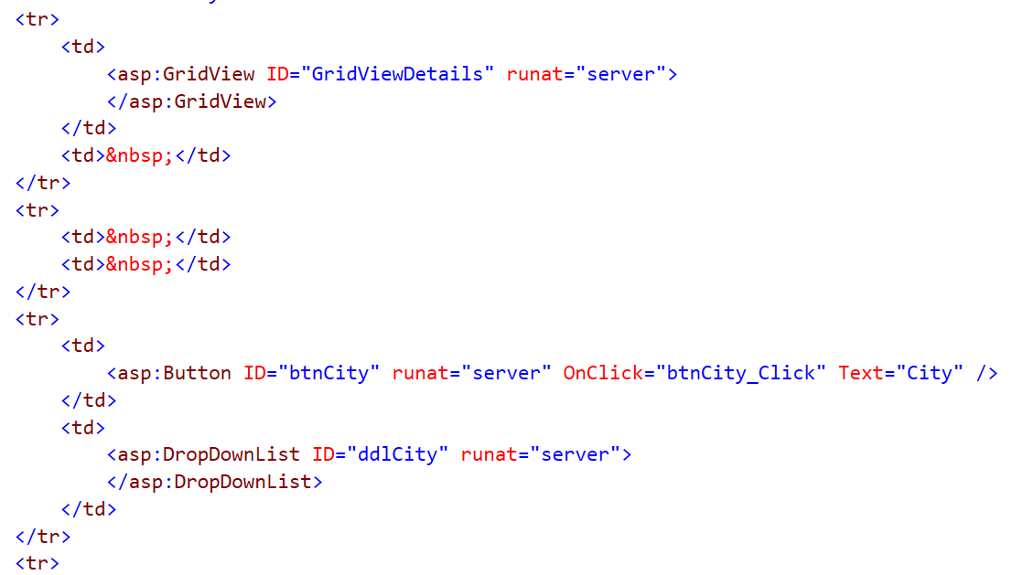
Notes:
Webform1.aspx

Slide 60
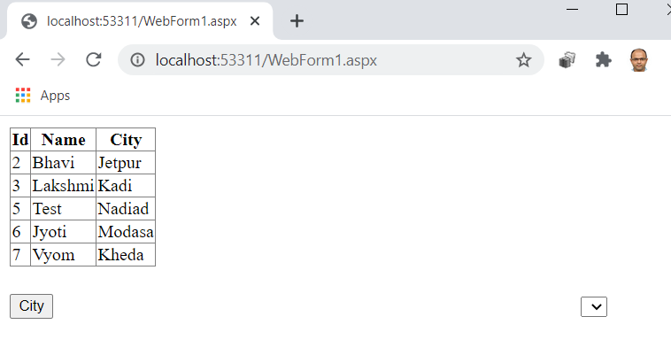
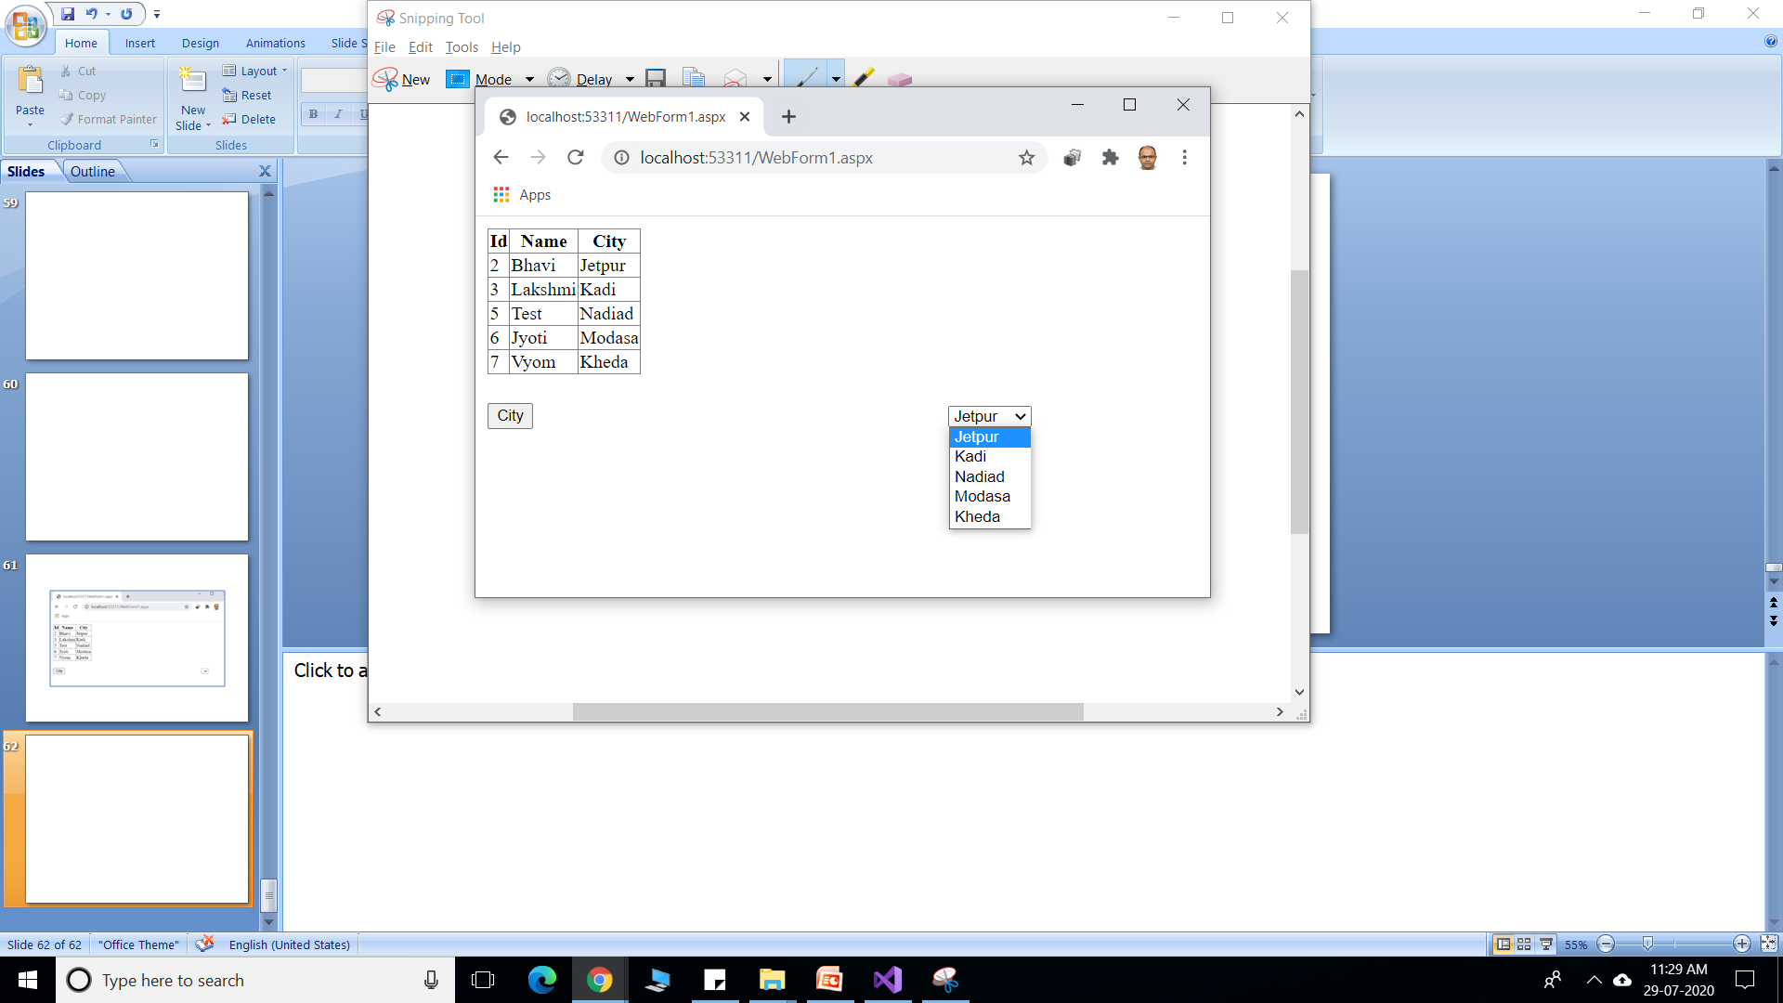
Notes:
Page Load
City button click

Slide 61
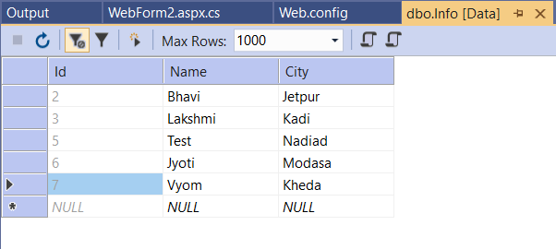
Notes:
Webform2

Slide 62
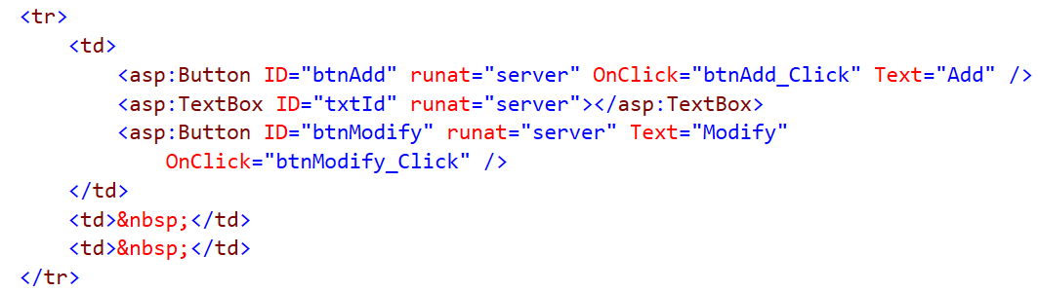

Slide 63
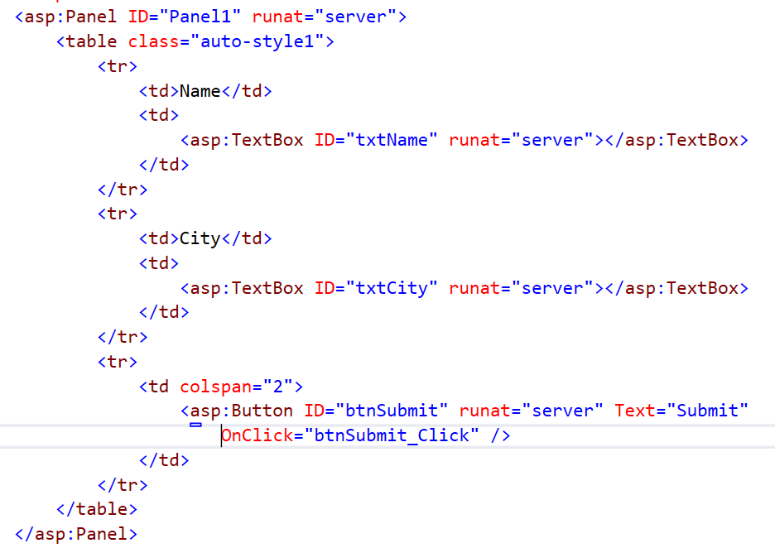

Slide 64
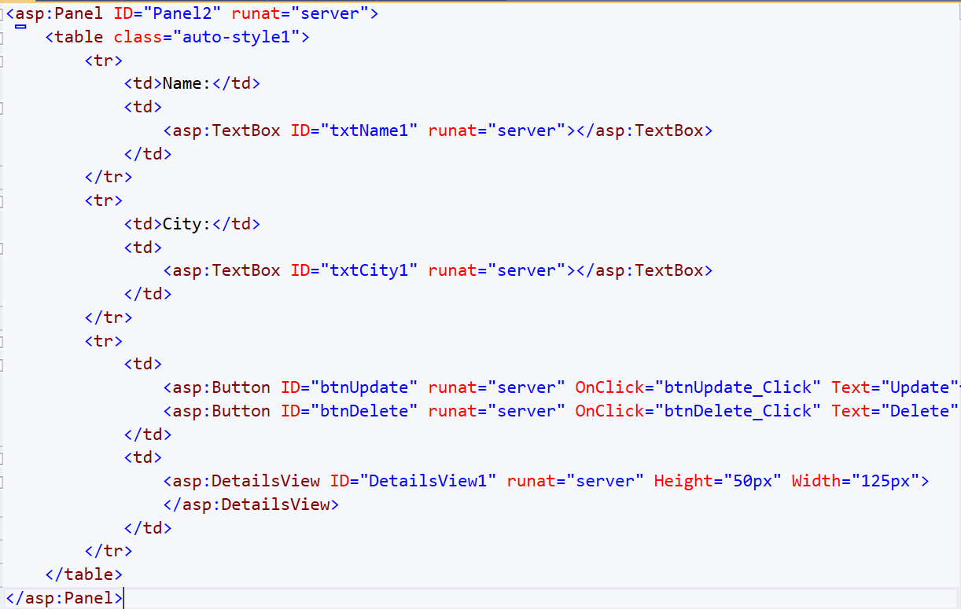

Slide 65
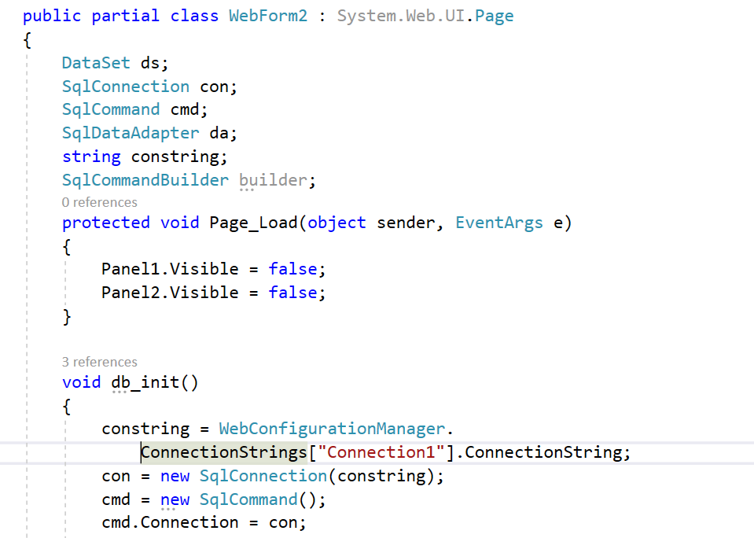

Slide 66
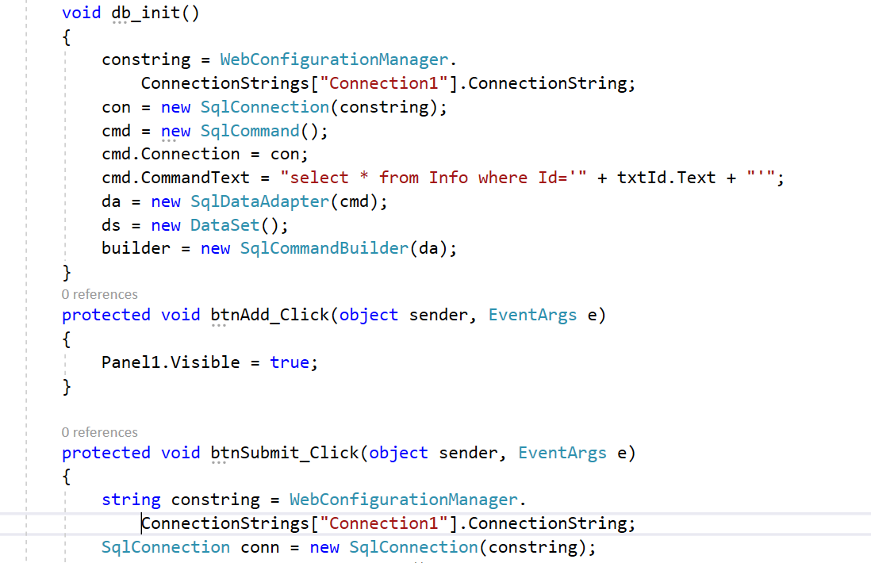

Slide 67
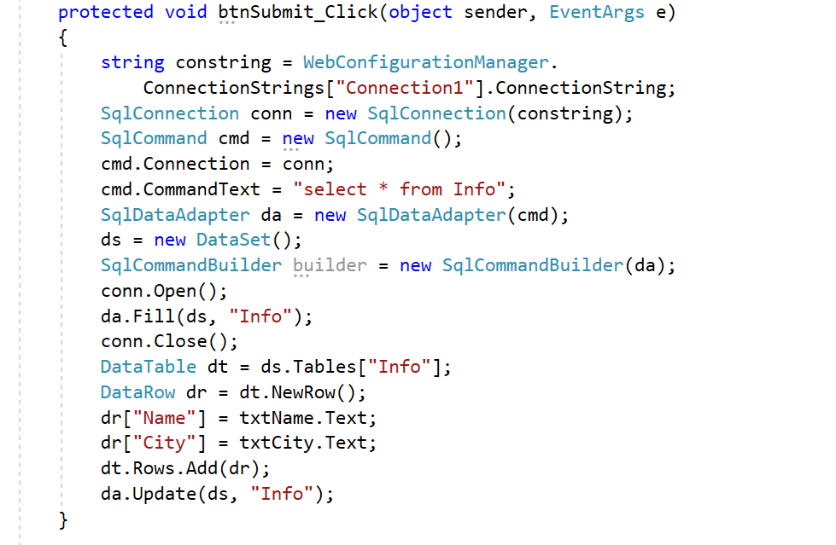

Slide 68


Slide 69

Notes:
Calling the AcceptChanges of the DataSet enables you to invoke the method on all subordinate objects (for example, tables and rows) with one call. When you call AcceptChanges on the DataSet , any DataRow objects still in edit-mode end their edits successfully.

Slide 70


Notes:
Page Load
Add click event

Slide 71


Notes:
Submit click
Changes reflected in table

Slide 72



Notes:
15 in textbox and click on ‘modi’fy
Update record and click update
Modified table

Slide 73


Notes:
Delete record 5.

Slide 74

Notes:
Data Bind and Data Source Control Demo
Web.config

Slide 75



Slide 76


Notes:
No code here in WebForm1.aspx.cs
Output.
From where this output is generated?

Slide 77




Slide 78

Notes:
We are using database created in another application.

Slide 79


Slide 80

Notes:
Test Query and Finish wizard steps.

Slide 81


Notes:
Bring Gridview control in aspx page

Slide 82


Notes:
See the change in gridview in after data source selection.

Slide 83


Notes:
Webform1.aspx code generated automatically.
Output.

Slide 84

Notes:
Webform2.aspx

Slide 85

Notes:
Click on Advanced... Tick mark first check box and Next and Finish

Slide 86

Notes:
Bring gridview control.
Attach sqldatasource and enable sorting, editing and deleting

Slide 87


Notes:
Webform2.aspx code

Slide 88


Notes:
Page Load
Edit click

Slide 89



Notes:
Update Age and Click on Update
Update is not shown immediately, then refresh.

Slide 90


Notes:
Record with id 4 is deleted. Only possible if reference record is not present as foreign key in another table.

Slide 91

Notes:
WebForm3.aspx

Slide 92


Slide 93


Slide 94


Slide 95

Notes:
Click on where

Slide 96

Notes:
cl

Slide 97

Notes:
Click on Add

Slide 98

Notes:
Click on OK

Slide 99


Slide 100

Notes:
Click Finish

Slide 101

Notes:
Details View. SqlDataSource2

Slide 102


Slide 103


Notes:
WebForm3.aspx

Slide 104



Slide 105


Notes:
Page Load and Select for record 1

Slide 106
DataReader | DataSet
Performance is better | Provides lower performance
It cannot modify data | It can modify data
It supports connected Architecture | It supports disconnected architecture
It has Read-only access | It has Read/Write access
It has faster access to data | It has slower access to data
Notes:
Revision

Slide 107
What is the difference between ExecuteScalar, ExecuteReader and ExecuteNonQuery?
Notes:
ExecuteScalar is typically used when your query returns a single value. If it returns more, then the result is the first column of the first row. An example might be
Select Count(*) from product
ExecuteReader is used for any result set with multiple rows/columns (e.g., SELECT col1, col2 from sometable).
ExecuteNonQuery is typically used for SQL statements without results (e.g., UPDATE, INSERT, etc.).

Slide 108
What is the DataAdapter Object in ADO.NET?
Notes:
A Data Adapter contains a set of data commands and a database connection to fill the dataset and update a SQL Server database. Data Adapters form the bridge between a data source and a dataset.
Data Adapters are designed depending on the specific data source. The following table shows the Data Adapter classes with their data source.
Provider-Specific Data Adapter classes Data Source
SqlDataAdapter SQL Server
OledbDataAdapter OLE DB provider
OdbcDataAdapter ODBC driver
OracleDataAdapter Oracle
A Data Adapter supports mainly the following two methods:
Fill (): The Fill method populates a dataset or a data table object with data from the database. It retrieves rows from the data source using the SELECT statement specified by an associated select command property. The Fill method leaves the connection in the same state as it encountered before populating the data.
Update (): The Update method commits the changes back to the database. It also analyzes the RowState of each record in the DataSet and calls the appropriate INSERT, UPDATE, and DELETE statements.

